Slide 1

Microsoft Movie Studios
Exploration of box offices successes and failures
Johnny Dryman

Slide 2

Overview
This analysis is designed to guide Microsoft through the early stages of film development and production.
We aim address the following questions:
What is the relationship between production budget and box office revenue?
Which genres are the safest bets for the first few films?
What MPAA rating makes the most sense for return on investment?

Slide 3
Methodology
All data was sourced from The Movie Database (TMDB) using their provided API.
Filters used:
Release year 2012-2019
Production budgets exceeding $1 million
Box office revenues greater than $0
Runtimes longer than 80 minutes
English language
Wide theatrical release
Notes:
TMDB api
Issues with provided dataset
filters

Slide 4
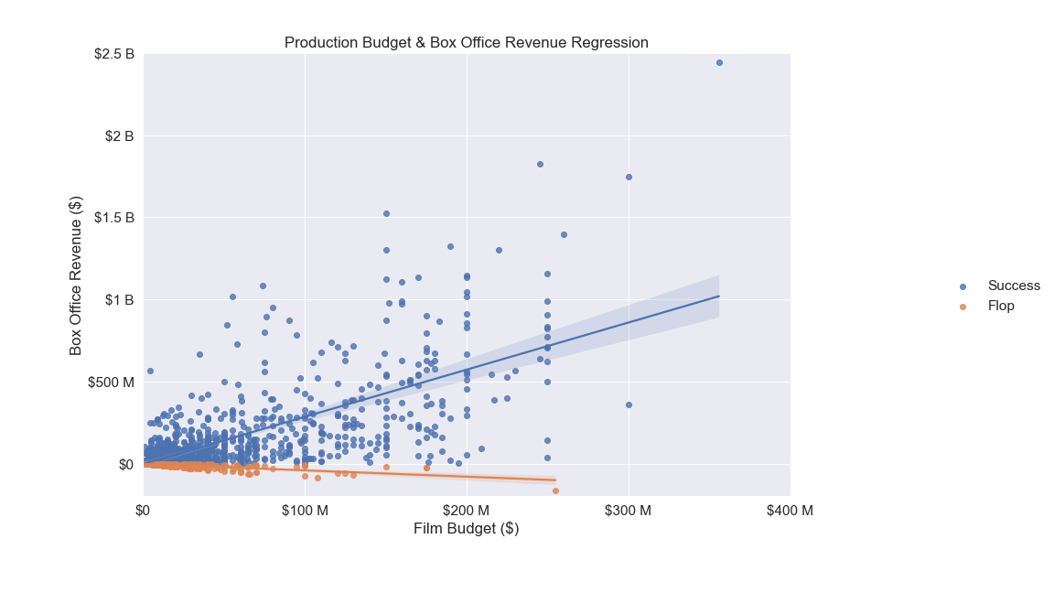


Slide 5
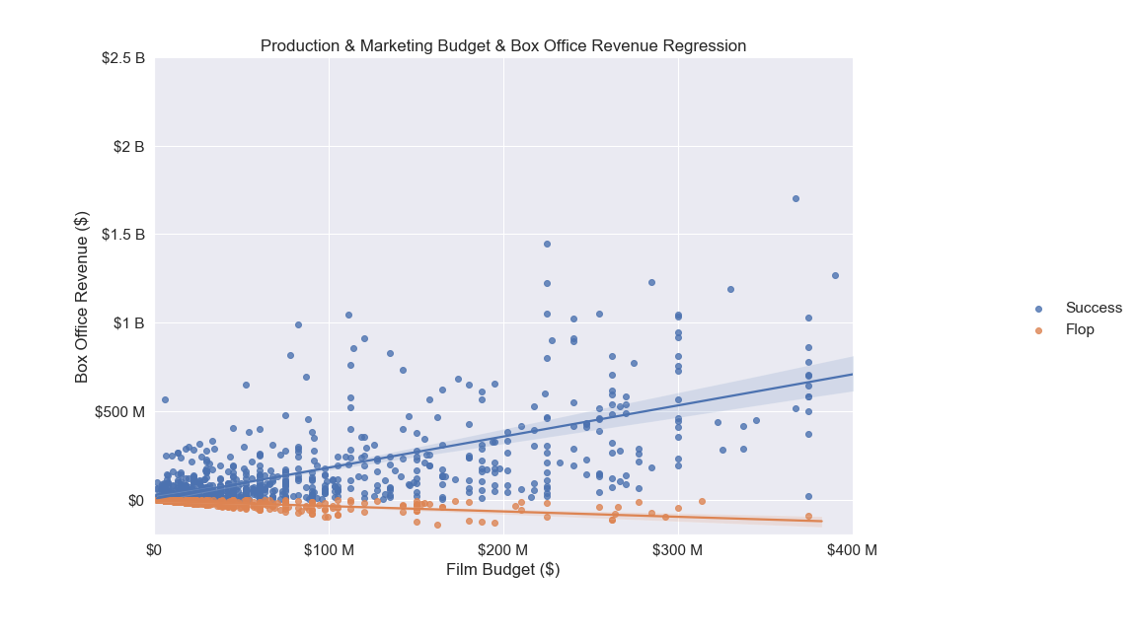
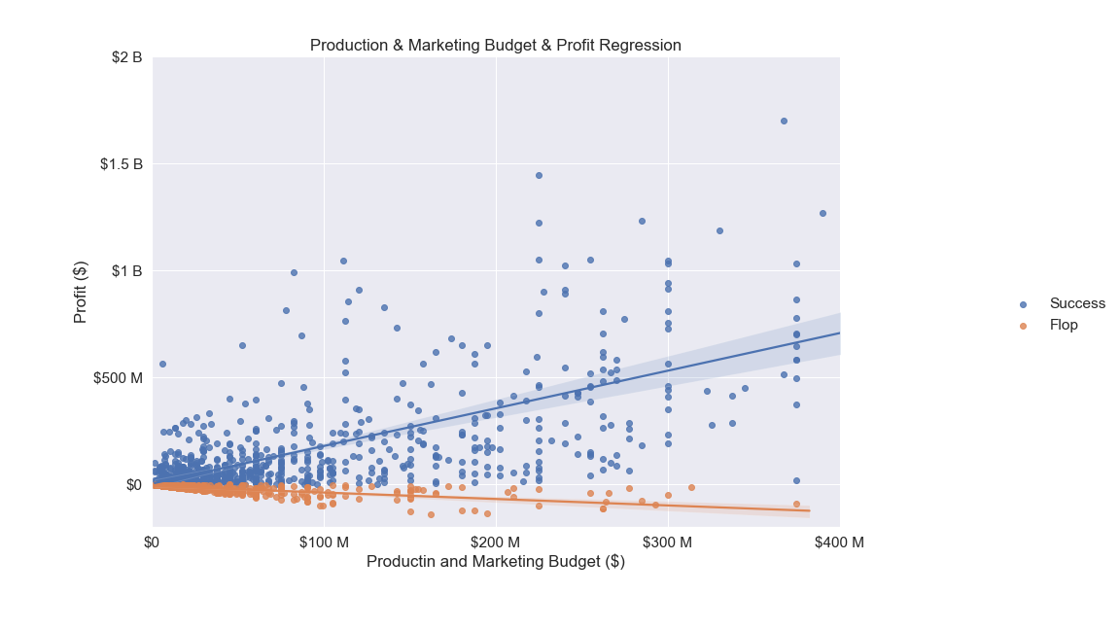

Slide 6
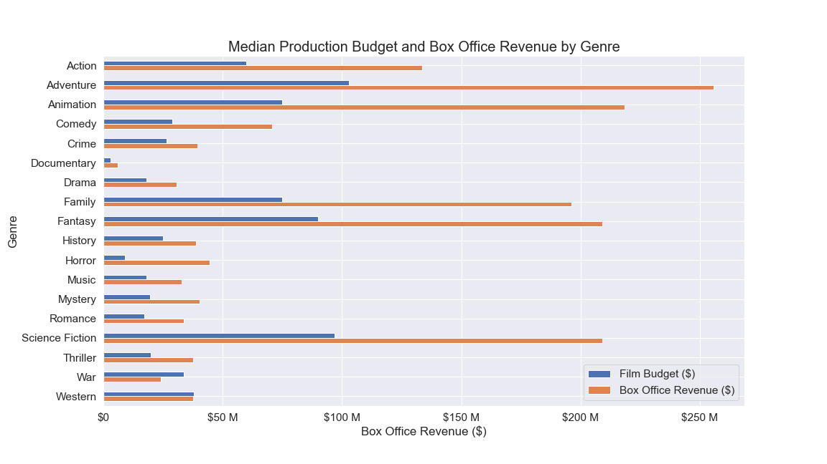

Slide 7
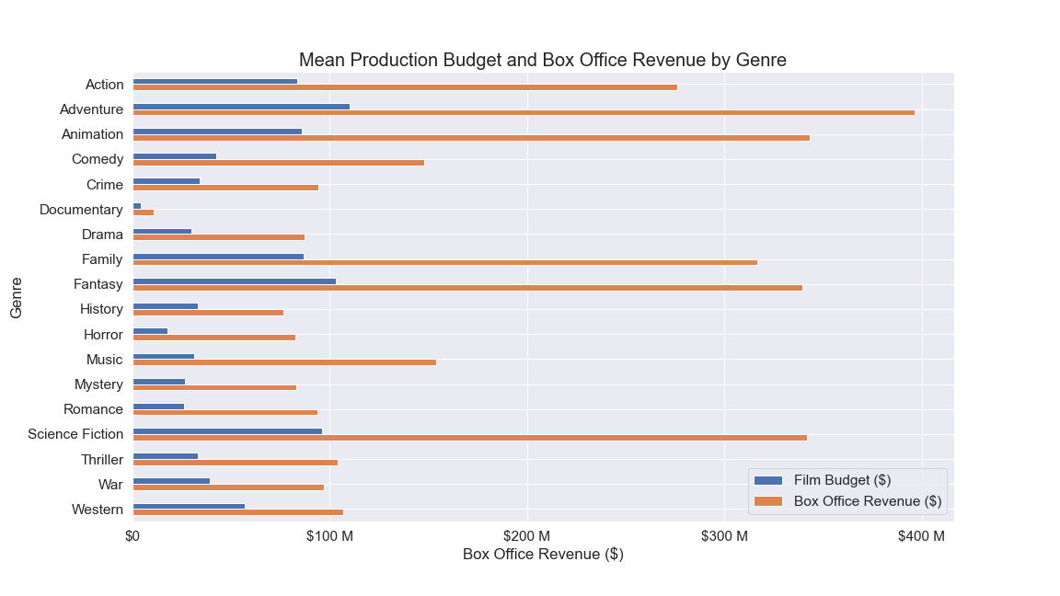

Slide 8
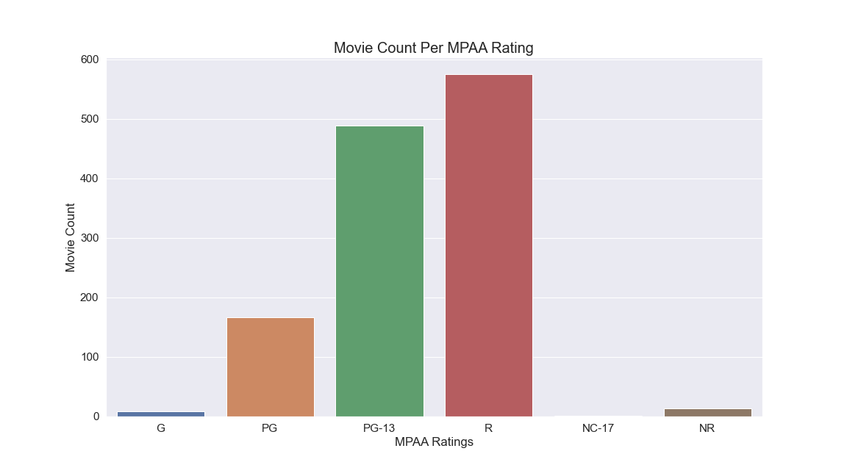

Slide 9
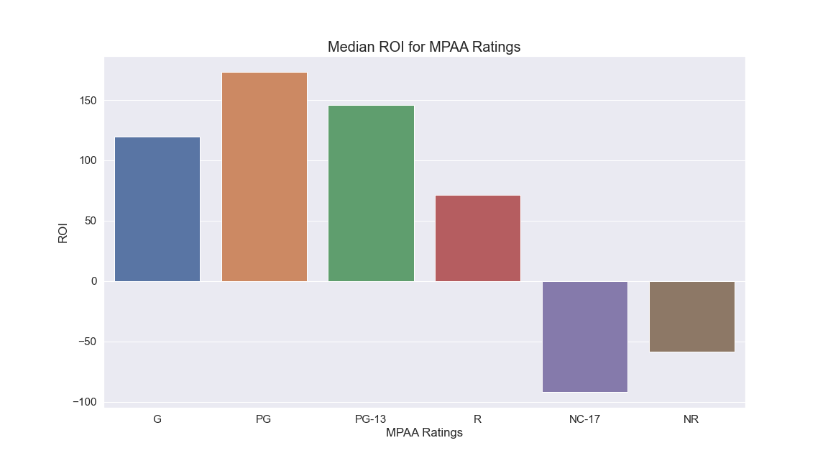

Slide 10
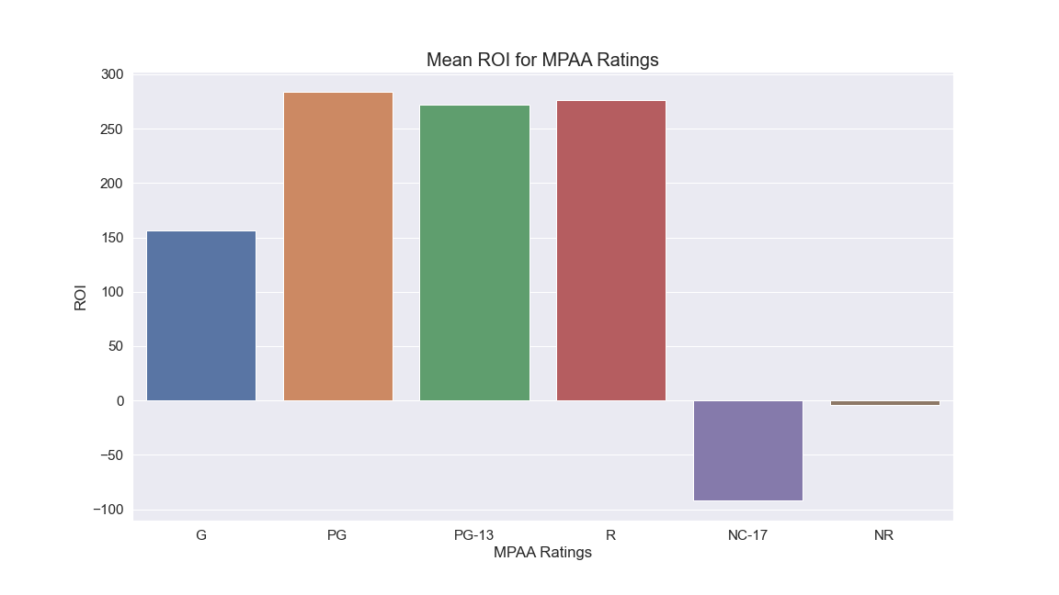

Slide 11
Conclusions
Budget and revenue are correlated, but avoid wasteful spending
Data represents studios with decades of experience
Microsoft is new to the business, and should allocate budgets with discretion
Focus on Adventure, Animation, Family, Fantasy, and Science Fiction genres.
Elements of action and comedy could be a bonus
Horror, Music, Mystery, Romance, and Thriller are profitable, but only with lower budgets
Appeal to all ages to maximize profit potential
PG and PG-13 ratings earn the highest ROI’s
R rated movies should be approached with more caution, NC-17 movies should be avoided entirely

Slide 12
Further Analysis
What are the commonalities of box office flops?
Further explore successes and flops by isolating instances in separate dataframes
Who are the winners and losers in the most profitable genres?
Investigate elements of strong and weak performers
Expand data to include multiple sources (e.g. Rotten Tomatoes)
Combine TMDB data with data from Box Office Mojo, The Numbers, Rotten Tomatoes, and Metacritic
Crystalize current dataset by ironing out financial discrepancies
Identify trends in critic and audience popularity

